Slide 1
Profiling the Biological Adversary
Gary Ackerman
February 23, 2018
This material is made possible by support from the Chemical and Biological Defense (CBD) Division, U.S. Department of Homeland Security, under award # 2012-ST-061-CS0001. The views and conclusions contained in this document are those of the authors and should not be interpreted as necessarily representing the official policies, either expressed or implied, of the U.S. Department of Homeland Security or START.

Slide 2
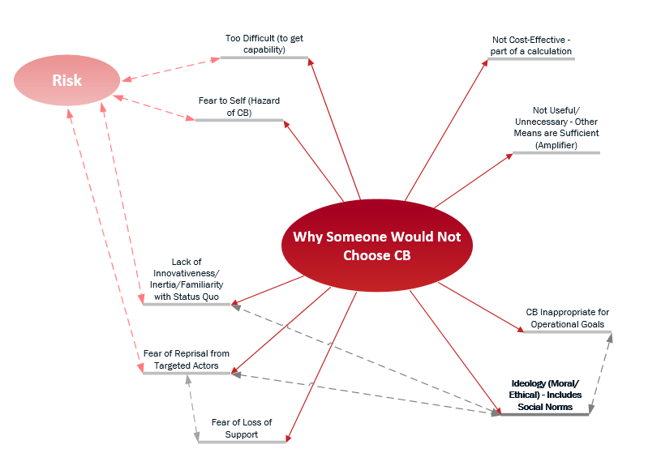
Reasons for Non-Pursuit of Biological Weapons

Slide 3
Seeking Answers Through Data Analysis
Analysis performed on:
Chemical and Biological Non-State Adversaries Database (CABNSAD)
  Primary dataset of all individual perpetrators
  Secondary dataset with all individuals that were members of organizations aggregated appropriately.
Types of Analysis:
Descriptive statistics
Bivariate correlations
Analysis of variance (ANOVA)
Simple linear regression
Multinomial logistic regression

Slide 4
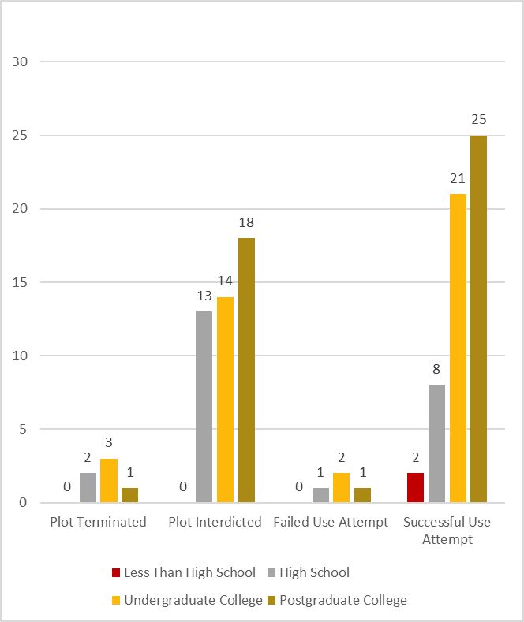
Sample Bivariate Comparison:
CB Activity results by Education Level

Slide 5
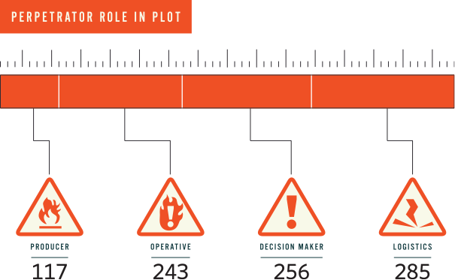

Slide 6
Key Takeaways: Data Analysis
Demographics
Education Levels | Biological perpetrators are generally more educated than chemical perpetrators.
Education Levels | The higher the level of education, the more likely a perpetrator was to successfully use the CB agent(s); vast majority of cases of CB use (with known education level) involve perpetrator with at least an undergraduate education.
Age | Successful perpetrators are generally older with more years of CB activity.
Origin and Activity | Majority of individual perpetrator originating from MENA moved to Europe or North America prior to engaging in CB activities.

Slide 7
Key Takeaways: Data Analysis
CB Activity
Perpetrator Type | Lone actors comprise over half of all perpetrator entities and are much more likely to use biological agents than any other perp type.
Organization Type | Members of a formal organization have far more CB activity years.
Casualties | Cults, such as Aum Shinrikyo and the People’s Temple, achieved highest number of casualties.
Casualties | Far more (non-fatal) injuries when perpetrator had a postgraduate college education.
Targeting | Majority of perpetrator entities targeted food and/or drink.

Slide 8
Biological Adversary Psychology
General Components
Full Psychological Model
Common (Cognitive) Process Toward Ideological Violence
Decision Point Model
Detailed Components Based On
Portions of the Literature Review
Motivation-Influencing Factors at each Decision Point
Analysis of Past Perpetrator Motivations and Behavior
Alternative Hypotheses
Portions of the IS Profile

Slide 9
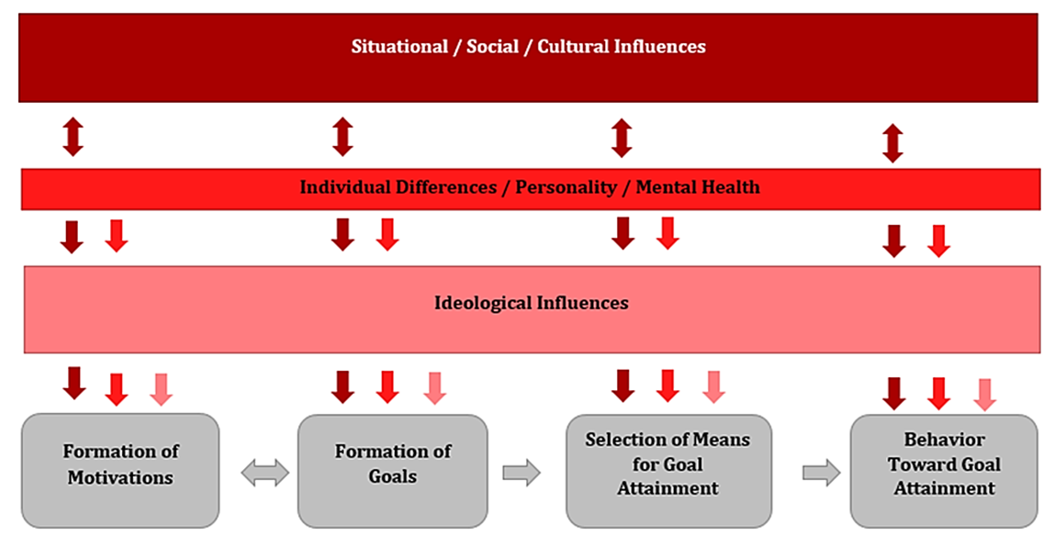
Bio Adversary Psychology Components

Slide 10
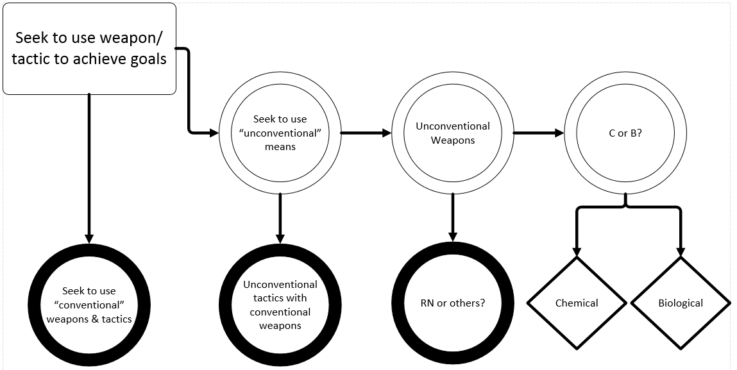
Psychological Decision Points in Use of Bio
Unconventional
  Area Denial (+++)
  Publicity (++)
  Catastrophic Casualties [50K] (+++)
  Disruption of Agriculture (+++)
  Deterrence (+)
  Status Building / Factionalization (++)
  Propensity to Innovate (++)
  High Technology Fascination (+)
  Narcissism / Self-Glorification (+)
  Lack of Interest in Innovation (- -)
  Low Risk Threshold for Failure (- -)
Weapons
  Large Scale Incapacitation (++)
  Area Denial (++)
  Psychological Impact (+)
  Publicity (+)
  Catastrophic Casualties [>100K] (+++)
  Water Supply (+)
  Immediate Gratification / Impatience / Urgency (- -)
  State Sponsor (- -)
  Low Self-Harm Threshold (- - -)
  Concerns about Counter-terrorism Reaction (- -)
Bio
  Desire to Harm but NOT Kill on a Large Scale (++)
  Bio Fetish (+++)
  Revenge for Previous CB Use (+++)
  Exclusive Targeting of IT Infrastructure (- - -)
  Targeting of CI (- - -)
  RN or C Fetish (- - -)

Slide 11
Bio Adversary Psychological “Profile”
Combining the results of the various analyses has enabled START to develop a preliminary psychological “profile” of VNSAs who seek to acquire and use CB weapons.
Result is subject to limitation and constraints and is not comprehensive.
Relevant VNSA traits and factors exist in the following categories.
Dispositional Factors
Situational Factors
Ideology
Motivation / Goals
Selection of CB Weapons as a Means of Goal Achievement

Slide 12
Key Takeaways: Psychological Profile
Dispositional Factors
Youth-Associated – actors under the age of 40, with a high risk tolerance, reliance on emotions in decision making, and propensity for violence
Intelligence and Education – CB actors are fairly well educated, with most having an undergraduate degree and many having a postgraduate degree
Mental Health Status – VNSAs with mental disorders that lead to a higher propensity for violence may be more likely to use CB weapons than those with mental disorders that lead to distortion of normal cognitive processes.
Situational Factors
Group Membership – Most CB actors have belonged to a group or unaffiliated cell
Social Influences Toward CB Weapons Use – Friends, family, colleagues and organizational leadership with beliefs/opinions about CB weapons use.

Slide 13
Key Takeaways: Psychological Profile
Ideology
Religious and Personal/Idiosyncratic – more likely to be associated with CB weapons use than other ideologies like criminal, cult, secular, ethno-nationalist and others
  Religious Islamic (Sunni) – Is the religious ideological subtype most strongly correlated with CB use
  Personal/Idiosyncratic – Is the ideological type most strongly correlated with CB use to attack an individual (often out of revenge for a perceived injustice)
Cult Ideology – associated most with successful use of CB weapons, including injuries and fatalities
BW vs. CW use – cults and those with secular left-wing ideologies are more likely to use both C and B weapons, whereas other ideological groups are more likely to pursue CW than BW

Slide 14
Key Takeaways: Psychological Profile
Motivation/Goals
Organizational or Ideological Group Membership – VNSAs who are members of a group or organization tend to adopt the group’s CB weapons goals and motivations
Non-Members of an Ideological Group – VNSAs who do not belong to an ideological group often have self-focused goals of harming someone who has harmed them, and are motivated by revenge
Selection of CB Weapons as Means to Goal Achievement
VNSA Groups/Organizations – Selection of CB weapons often occurs when they are required to achieve a larger goal, or when CB weapons are easy to access and use
Lone Actors – Selection of CB weapons is usually utilitarian, and use of CB weapons is integral to achieving a larger goal

Slide 15
Bio Adversary Threat Indicators
Added psychological findings to existing set of Bio Adversary Threat Indicators
Packaged into user-friendly Excel worksheet

Slide 16
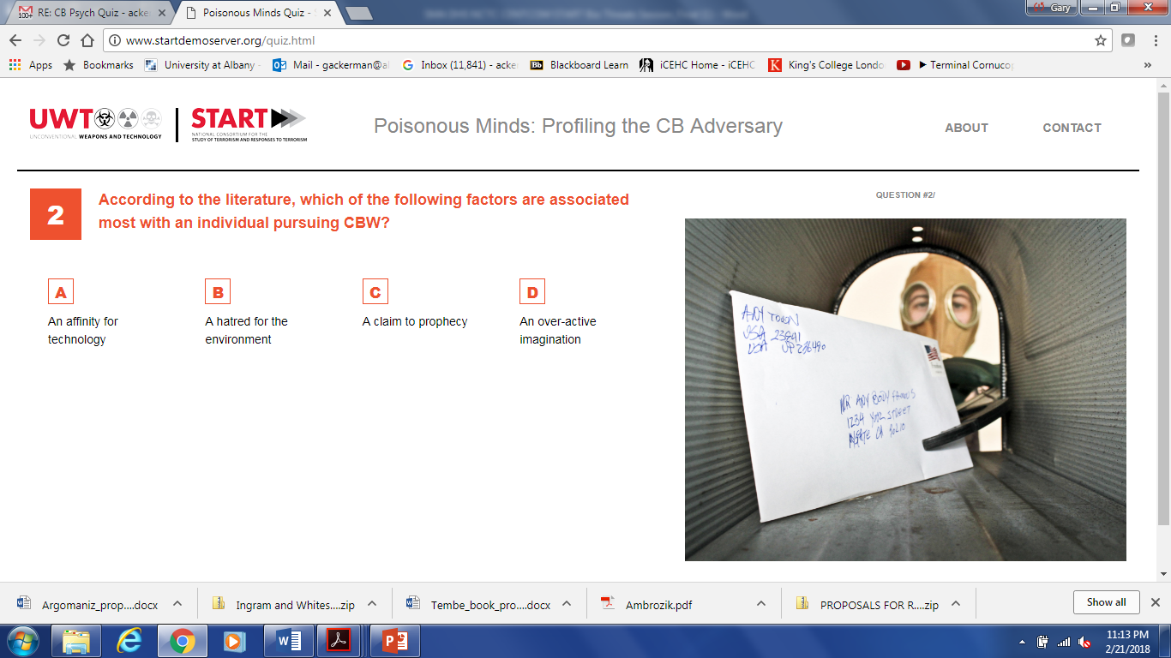
Learning Quiz: Poisonous Minds
Beta Version: www.startdemoserver.org

