Slide 1
Afghanistan-Pakistan Relations: Sources and Outlook
Karl Kaltenthaler
Department of Political Science
University of Akron and Case Western Reserve University

Slide 2
A Brief Summary of the Present State of Afghan-Pakistan Relations
Afghanistan and Pakistan are locked into a complex security dilemma
There is very little trust
Both countries view the other as a crucial security threat
Attempts to improve relations by both sides have failed
These attempts fail because of the multiple, deeply-rooted reasons why the countries distrust each other

Slide 3
Sources of the Afghanistan-Pakistan Security Dilemma
Afghanistan does not recognize the Durand Line as the official border with Pakistan
Afghanistan sees itself as the home of the Pashtuns, who are split between the two countries
Pakistan deeply fears Pashtun nationalism
Afghanistan has fostered Pashtun nationalism in Pakistan from time to time

Slide 4
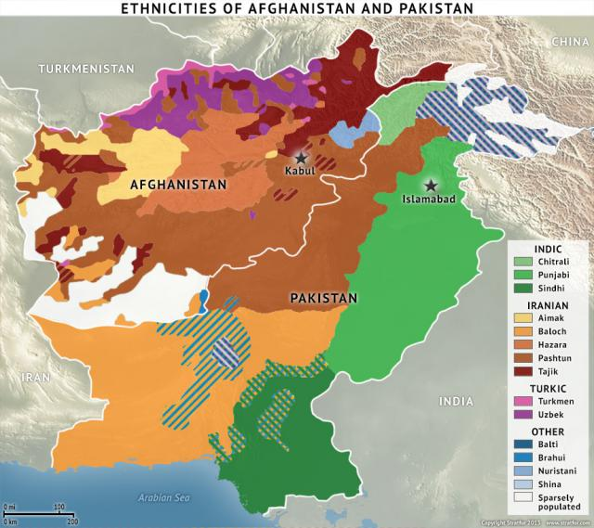
Afghanistan-Pakistan Ethnic Population Distribution

Slide 5
Sources of the Afghanistan-Pakistan Security Dilemma (Continued)
Afghanistan has traditionally been friendly with India
Taliban rule was an exception
Afghanistan now has several anti-Pakistan groups operating from its side of the border
Tehrik-e-Taliban Pakistan (Pakistani Taliban)
Balochi nationalist militant organizations
ISIS in Afghanistan (Islamic State-Khorasan)
Large US military and intel presence in Afghanistan
Pakistan deeply distrusts US intentions in Afghanistan and toward itself
The US interests do not line up with those of Pakistan

Slide 6
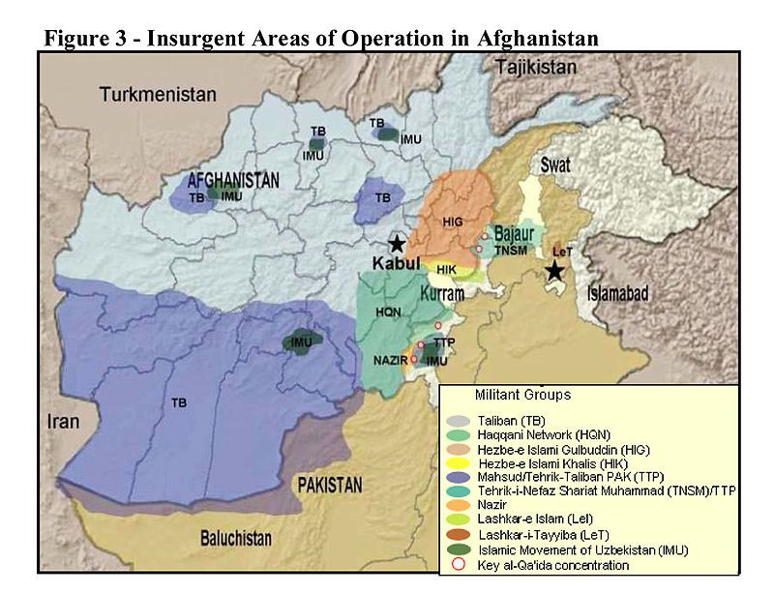
Insurgents Areas of Operations in Afghanistan

Slide 7
Sources of the Afghanistan-Pakistan Security Dilemma (Continued)
Pakistan has an active mixed modality campaign to topple the Afghan government and have it replaced by the Taliban
Pakistan actively supports the:
Quetta Shura Taliban
Haqqani Network
Other anti-Afghan regime elements
Pakistani jihadi groups that operate in Afghanistan

Slide 8
Sources of the Afghanistan-Pakistan Security Dilemma (Continued)
Supporting the Taliban serves several purposes for Pakistan:
Undermines Pashtun nationalism by offering militant Islamism in its place
Keeps Afghanistan weak and on its heels
Will hopefully result in a new Taliban government that will keep out Indian, US, Iranian, and Russian influence
Avoiding Indian encirclement is most important goal
A pro-Pakistan Afghanistan also provides strategic depth for Pakistan
Pakistan does not want chaos in Afghanistan

Slide 9
The Way Forward for Pakistan and Afghanistan
The Taliban is not winning nor is it losing
Pakistan will not abandon its efforts in Afghanistan
A destabilized Afghanistan is better than one that is safe for India to use against Pakistan
Pashtuns could turn away from Islamism toward nationalism
Pakistani jihadi groups could turn against the Pakistani state

Slide 10
The Way Forward for Pakistan and Afghanistan (Continued)
Pakistan views the situation as one of existential importance
It will not abandon its support for the Afghan Taliban
It does not matter how much pressure the US and others exert on it
Presently-configured Afghanistan represents an existential threat to Pakistan
Pakistani military-intelligence leaders would rather “eat grass” than allow India to take a permanent, unmolested foothold in Afghanistan

Slide 11
Implications for the US
Confidence-building measures from the Afghan side will do little
Security guarantees from the US will not be trusted by Pakistan
Ways to reduce the Afghanistan-Pakistan security dilemma:
A stabilized, neutral, Afghanistan that drops its claims to Pashtuns in Pakistan
Serious movement toward a lasting peace between India and Pakistan
These are very unlikely to occur in the near term, even with US diplomacy backing them

