Slide 1
KOREA STRATEGIC OUTCOMES: implications for german-speaking and east-central EUROPE (gs-ece)
David R. Dorondo, Western Carolina University (STRATCOM Deterrence and Assurance Academic Alliance)

Slide 2
Disclaimer (of sorts…)
These are observations of an historian of European military and political history and the history of modern international relations (though I am no historical determinist).
They are not observations of a political scientist engaged with IR theory.
At the level of IR theory, however, I incline toward the “classical realism” of Reinhold Niebuhr and Hans Morgenthau (https://plato.stanford.edu/entries/realism-intl-relations/).
What follows is “a” view from Europe, not “the” view. It emphasizes German-speaking and East-Central Europe, for reasons which follow, and is subject to revision, particularly if the German government falls and/or a U.S.-Russia summit occurs in July.

Slide 3
“When we try to pick out anything by itself, we find it hitched to everything else in the universe.” John Muir (1838-1914)

Slide 4
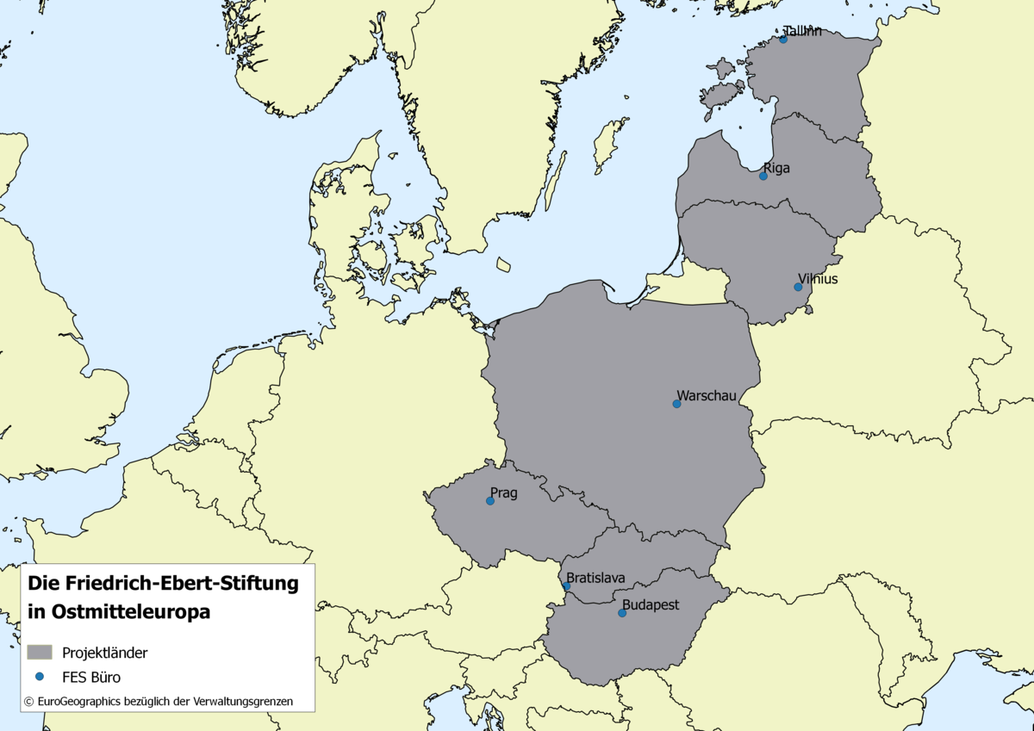
German-speaking and East-Central Europe
RUSSIA
BELARUS
FRG
UKRAINE
AUS
RUM

Slide 5
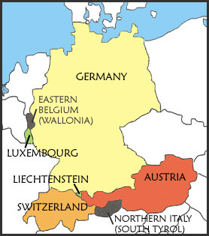
German-Speaking Europe (gse) source for figures: cia world factbook 2017
Federal Republic of Germany, Austria, Switzerland, Luxembourg, and Liechtenstein
Aggregate GDP: $4,812,092,000,000 (FRG’s GDP alone is > $4 trillion)
Aggregate population: 98,217,107
Aggregate area: 484,916 sq km
Nota bene: “Wallonia” is incorrect.
Notes:
Insert a picture of one of the geographic features of your country.

Slide 6
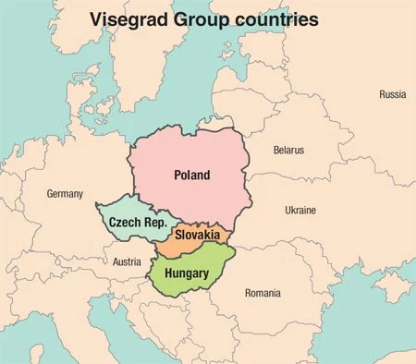
visegrÁd group of states
Named after Congress of Visegrád (1335) between John I of Bohemia, Charles I of Hungary, and Casimir III of Poland
Poland and Hungary (PH): dominant States of the Visegrád Group
Aggregate GDP of PH: $642 billion
Aggregate population of PH: 48,327,114
Aggregate area of PH: 405,713 sq km
Notes:
Insert a picture illustrating a season in your country.

Slide 7
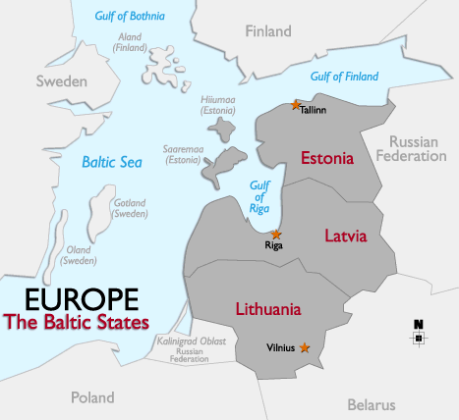
BALTIC states
Estonia, Latvia, and Lithuania
Aggregate GDP of the Baltic States: $102.53 billion
Aggregate population: 6,020,083
Aggregate area: 175,117 sq km
Note the approx.100-km wide (approx. 60 mi) Suwalki Gap b/t the Kaliningrad Oblast and Belarus. Isolated from NATO and w/ approx. 1 million Russians living among them.
Notes:
Insert a picture illustrating a season in your country.

Slide 8
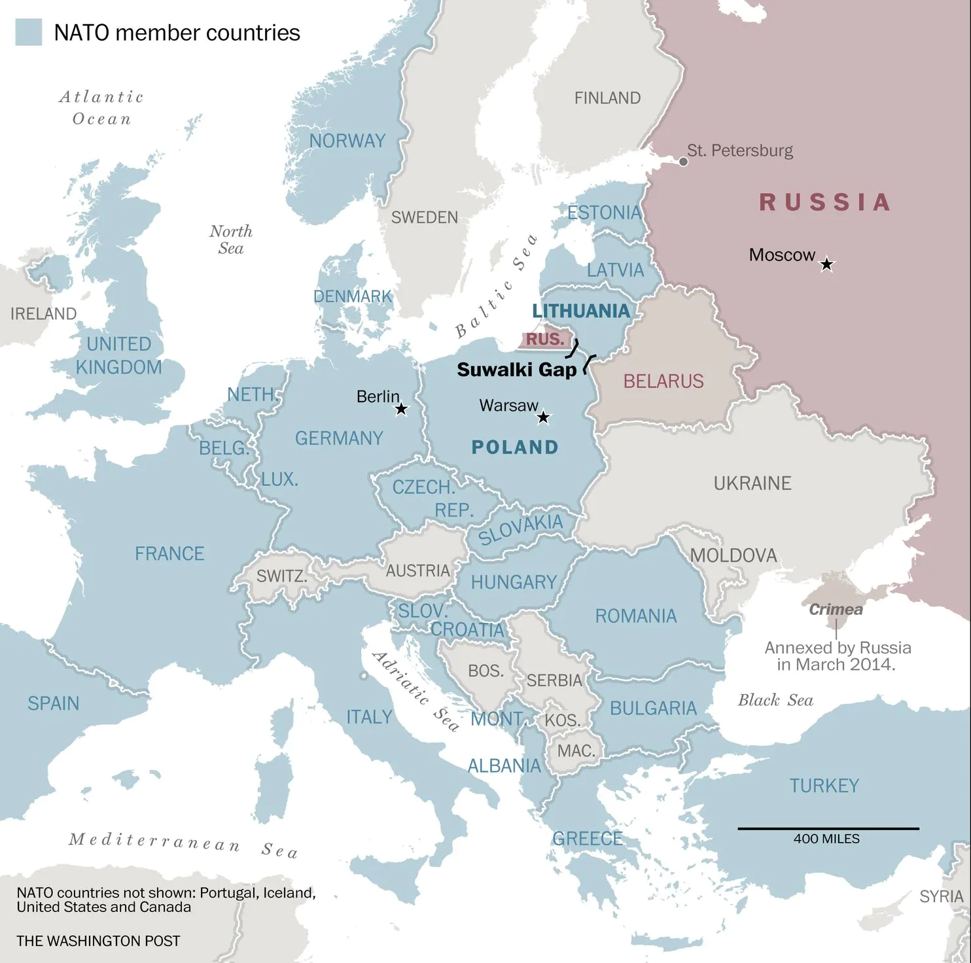
The Suwalki Gap in larger NATO context

Slide 9
RATIONALE for U.S. policy makers to pay attention to gs-ece:
Germany is one of the 3 most important EU member-States. It had the world’s 4th largest economy as of 2017. It is Europe’s most powerful non-nuclear State and a critical member-State in NATO.
Germany is a P5 + 1 signatory to the JCPOA with Iran of 2015.
Alongside South Korea, Japan, and Australia, Germany is one of the world’s 4 leading non-nuclear States and is the PRC’s largest European bi-lateral trading partner (> €186.8 billion imports + exports in 2017 [approx. $215 billion]).
Germany is a major target of PRC investment (“Made in China 2025;” “New Silk Road”) and China’s principal European interlocutor (11 visits by Chancellor Merkel to date).
Germany is also Europe’s principal interlocutor with Moscow regarding Ukraine. Major investor in, and object of, Russian economic coöperation (oil, natural gas, machine tools, etc.).
Berlin is dominant in German-speaking Europe, among the Visegrád States, and in the Baltic States, but Germany must tread softly due to historic memories of WWI and WWII.
Austria is home to the IAEA (Vienna; DPRK verificatory role?) and holds the EU Council’s presidency as of 1.VII. Natural connection (not always agreement) b/t Germany and Austria. Vienna possible site of a U.S.-Russia summit in July?
Taken together, GS-ECE constitute a major non-nuclear group of States in the European Union.
Notes:
Insert a map of your country.

Slide 10
gains for Russia from U.S.-DPRK summit and recent g-7 debacle:
In GS-ECE:
Russia supports a “freeze-for-freeze” in NE Asia, assuming that it holds. U.S. military activity and presence is thereby reduced. Therefore…
Continued weakening of GS-ECE solidarity in face of conceivable “freeze-for-freeze” demands in the region? Russia’s historic geo-strategic advantage remains over and against U.S. transatlantic reinforcement. (There is already sometimes vocal GS-ECE criticism of US military activity and the European Deterrence Initiative, reinforced by the memory of the German-Soviet War 1941-1945.)
Russia is already well received by Moscow’s “Trojan horses.”
In NE Asia:
Russian/DPRK/PRC border stability is maintained. Diplomatic relations with both DPRK and ROK.
Russian trade with DPRK resumes if sanctions are lifted. Fifty percent of DPRK’s trade was with USSR during the 1970s and 1980s, though it is currently <1%. (SCMP, 25.VI.18)
In 2015, South Korea ranked as Russia’s seventh-largest trading partner for exports and imports. (National Interest, 6.II.18)
Notes:
Insert a map of your country.

Slide 11
MOSCOW’s Trojan horses? Putin’s Willing and unwilling benefactors…
Germany: Former Chancellor Gerhard Schroeder, Northstream 2, etc.; Alternative for Germany (AfD); The Left Party (Die Linke).
Austria: Former Chancellor Alfred Gusenbauer, the “Habsburg group,” etc.; the Freedom Party of Austria (FPÖ).
Hungary: Prime Minister Viktor Orbán and Fidesz; Jobbik.
Czech Republic and Slovakia: President Miloš Zeman and PM Robert Fico, respectively. The latter resigned III.18 after the murder of a noted journalist (replaced by like-minded successor).
Also, e.g., parties and leaders in France, the Netherlands, Italy, Greece, Denmark, etc. (but not generally in Poland and the Baltic States due to the memories of 1939-1989).
Migration crisis as important wedge-issue for Russian information-warfare, esp. in Germany, Austria, Poland, Hungary, the Czech Republic, and Slovakia. A collapse of Germany’s government over migration and resultant elections would weaken GS-ECE responses to Russian “active measures” on all issues. Potential large gains for AfD.
All of the above strengthened by U.S. behavior at G-7, resulting in difficulties for pro-U.S. actors. Reinforced further by post-Singapore “atmospheric deflation,” a rumored U.S.-Russian summit, and possible friction at upcoming NATO summit in July.

Slide 12
Take-away (1): what kind of Europe is better for U.S. in the last 200 years?
Consider:
1812 – U.S. drawn into a European war due to a hegemon’s actions (France).
1917 – Ditto (Germany).
1941 – Ditto (Germany).
Cold War – Ditto (USSR).
2018 and beyond…? (Russia and other authoritarians?).
Therefore:
A Europe at peace.
A Europe of wehrhaft democracies vis-à-vis both the radical Right and the radical Left.
A Europe open to trade with the U.S. (but also a U.S. open to trade with Europe).
A Europe defending free democratic institutions in league with the U.S. (See Art. 2 of the NATO Treaty)
Notes:
Insert a picture of an animal and or plant found in your country.

Slide 13
Take-away (2): what kind of Europe is worse for U.S. IN the last 200 years? What questions must be asked?
Consider:
A Europe threatened by hegemons. War often resulted and drew in U.S. (1812, etc.)
A Europe not open to U.S. trade. U.S. exports and jobs suffered. (1930, H.S. Tariff)
A Europe not open to political coöperation with the U.S. by virtue of European reluctance or U.S. isolationism. U.S. lost or, worse, abdicated ability to influence events directly. (1918 – 1939)
Therefore:
What of the threat of Russian hegemony if GS-ECE/EU or NATO weakens in 3/5/10 years?
What of Chinese economic penetration in 3/5/10 years?
Can U.S.-NATO ties survive if U.S.-European economic and political ties collapse? After 70 years, can the former continue without the latter?
Can Washington and Berlin create a modus vivendi?

Slide 14
Take-away (3): is today different?
Consider:
1966: French w/d from NATO causes transatlantic division
1968 – 1975: Vietnam, domestic issues, agitprop cause transatlantic division
1980 – 1984: Pershing II, “Star “Wars,” agitprop cause transatlantic division
2003 – 2008: Iraq causes transatlantic division
But:
Heretofore never any fundamental transatlantic divide over alliances, free trade, democratic norms, and the reliability and value of U.S. leadership. Now there certainly appears to be such a divide.
All intensely aggravated by spreading authoritarianism in Europe and elsewhere.

Slide 15

Memory as motivation…
“Memory is the mother of all wisdom.” Aeschylus (c. 525 - c. 456 BCE) Prometheus Bound
Notes:
Insert a picture illustrating a custom or tradition here.

