Slide 1
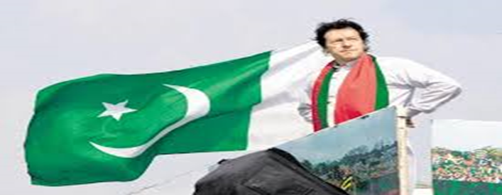
Imran Khan and Pakistan’s Role in a Potential Grand Bargain
Karl Kaltenthaler
University of Akron/Case Western Reserve University

Slide 2
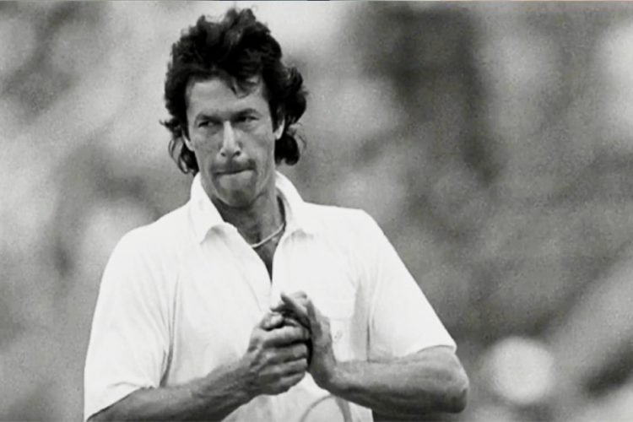
Imran Khan’s Background
Pakistani cricket star
Former playboy turned quite religious
Telegenic speaker and astute campaigner
Has never held political office until now
Pashtun

Slide 3
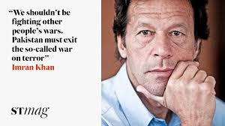
Political Profile
Won the election by a wide margin
Conservative populist
Pakistani nationalist
Anti-corruption reformer
Anti-American
Hardline on India
Pro-China
Sympathetic to Afghan Taliban
Determined opportunist
Close to the security establishment

Slide 4
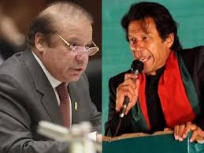
How Did Imran Khan Win?
By not been tainted by corruption in office
By tapping into the issues most Pakistanis care about
Corruption
The economy
Religion
Sovereignty
By having the security establishment help during the campaign and during the election
By his charisma

Slide 5
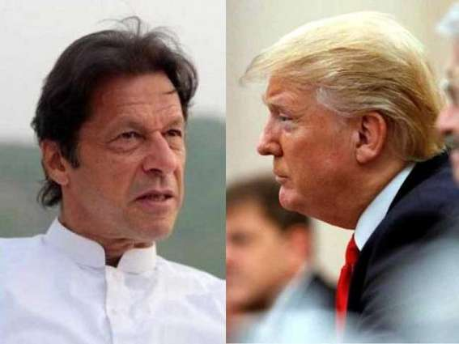
What Major Challenges Does Khan Face?
Economy
Balance of payments crisis
Confrontation with the US
International isolation
Domestic security
Energy crisis
The inevitable letdown

Slide 6
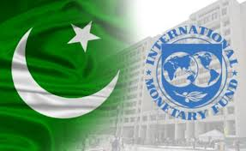
What Will Khan Likely Do to Meet Challenges?
Turn to IMF
Will not bend to US on Afghanistan in order to get loan
Depend on China/status quo
Strengthen ties with Russia
Will taper some of his anti-American rhetoric but not much
Status quo on India and Afghanistan

Slide 7
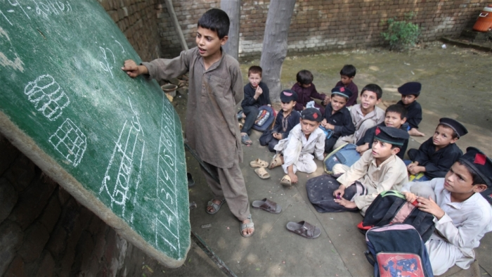
Will He Change Pakistan Domestically?
Not much if at all
Two things will keep this from happening:
1.) Vested military and economic elite interests
-Will even block major anti-corruption changes
2.) Pakistan is running on fumes
-No funds for big changes

Slide 8
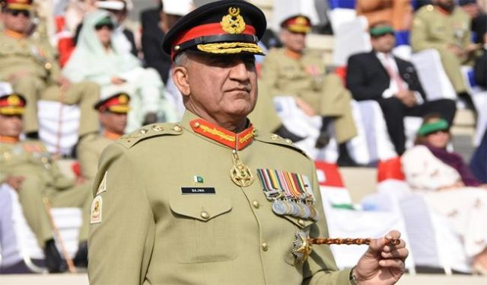
Will Imran Khan Change Pakistan’s Foreign Policy?
No
He does not control it
He would be removed if he tried to change it
He does not want to change it

Slide 9
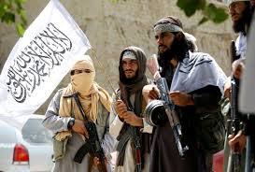
Can Imran Khan Bring Pakistan to a Grand Bargain on Afghanistan?
He has no independent authority over Pakistani policy toward Afghanistan
He is more sympathetic to the Afghan Taliban than past two PMs have been
Real question is: What Grand Bargain would the Pakistani security establishment accept?

Slide 10
What “Grand Afghanistan Bargain” Would the Pakistani Security Establishment Accept?
Not a Grand Bargain, but its top preference would be an outright Taliban victory
Second preference would be a power-sharing arrangement with Taliban in most powerful positions (Grand Bargain to them)
Eventual marginalization of non-Taliban politicians
Third preference would be the status quo with the Afghan government on its heels
The Grand Bargain it would accept would not be a bargain for the US

Slide 11
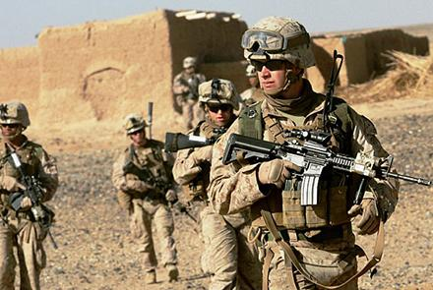
Can the US Leverage Khan into A Deal on Afghanistan?
No
He does not want to make any changes in Afghanistan policy
He cannot
No amount of pressure will change that

Slide 12
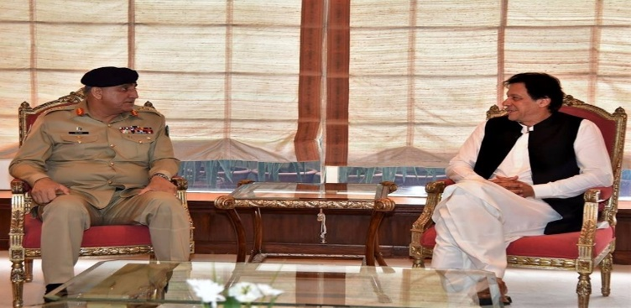
Major Take-aways
Imran Khan’s election is not good news for the US when it comes to Afghanistan
Nor is it really bad news; more of the same
Khan has no significant power over policies toward Afghanistan
He will not threaten his grip on power to challenge the military’s position on Afghanistan
He will not be helpful in bringing Pakistan into a Grand Bargain that is in US interests

