Slide 1
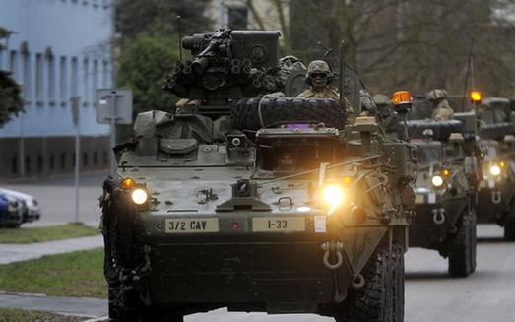
WHAT DETERS AND WHY
Assessing Requirements for Effective Deterrence
Michael J. Mazarr

Slide 2
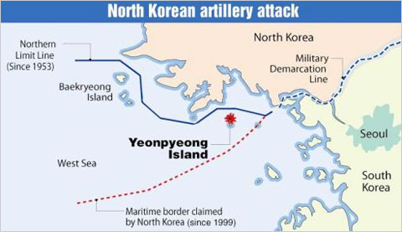
The Challenge: Rethinking Deterrence
Growing pressure from Russia, China, DPRK
Thinking on deterrence stale, recommendations not linked to empirical evidence
Focus: Conventional inter-state aggression
Review existing research, conduct new case studies

Slide 3
Study Question and Research Components
Literature Review
Framework
Data Set Test
Case Study Test
Russia – Baltic Application
Conduct an analysis of fundamental deterrence theory and its potential applications to challenges of inter-state aggression, including a specific case study of deterring Russian aggression in Europe.
Products
Review of deterrence theory and fundamentals
Framework for assessing health of deterrence situation
Assessment of Baltics

Slide 4
Evaluation of Framework: Quantitative Analysis and Case Studies
Post-1945 Data Set
Developed list of all post-1945 cases of extended & central deterrence (41 cases)
Code each case with 6 or 7 variables drawn from categories in list
Assess broad results, trends, correlations (no regression analysis)
Case Study Tests
Apply framework to 4 major case studies (Iraq 1990, West Berlin in Cold War, Georgia 2008, Nordic region in Cold War)
Validate, adjust variables
Russia-Baltics Application
Russian views of deterrence
Assessment of deterrent strength
Recommendations for bolstering

Slide 5
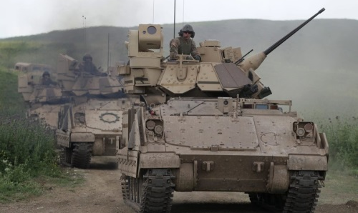
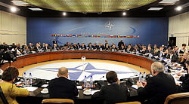
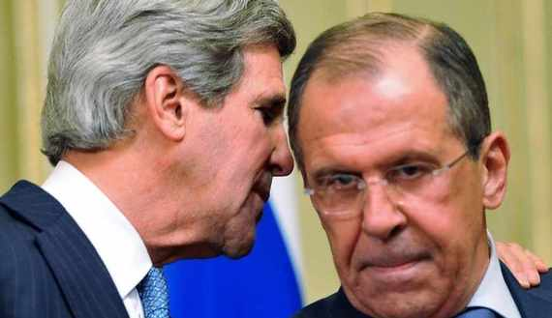
Defining Deterrence … and Dissuasion
Military threats, usually to prevent or discourage a state from undertaking military aggression
Military and non-military threats to prevent or discourage a state from taking unwanted actions
Threats and inducements to reduce the perceived need for and prospects for success in an unwanted action
Narrowest Concept
Broadest Concept
Proposed study definition:
The use of military or non-military deployments, threats and assurances to avoid the recourse to aggression by the target state
Rationale for the broader approach:
Decisions for war are about far more than vulnerabilities or opportunities
Narrow concept will not provide decision makers with effective framework
Threats alone provoke as often as they deter
Puts focus on aggressor perceptions

Slide 6
Key Variables Governing Success of Deterrence
Category | Variable
How Motivated Is the Potential Aggressor? | General level of dissatisfaction with status quo and determination to create a new strategic situation
 | Degree of fear that the strategic situation is about to turn against them in decisive ways
 | 3. Level of national interest involved in specific territory of concern
 | 4. Urgent sense of desperation, need to act
Is the Defender Clear and Explicit Regarding What it Sought to Prevent and What Actions It Would Take in Response? | Precision and consistency in the type of aggression the United States seeks to prevent
 | Clarity and consistency in the actions that will be taken in the event of aggression
 | Forceful communication of these messages to outside audiences, especially potential aggressor(s)
 | 4. Timely response to warning with clarification of interests, threats
Did the Aggressor View the Defender’s Threats as Credible and Intimidating? | Actual and perceived strength of the local military capability to deny the presumed objectives of the aggression
 | Degree of automaticity of U.S. response, including escalation to larger conflict
 | Degree of actual and perceived credibility of political commitment to fulfill deterrent threats
 | 4. Degree of national interests engaged in state to be protected

Slide 7
Fundamental Deterrence Relationship A dialogue between a clear and credible threat and the intensity of an aggressor’s perceived need to act
Perception of strategic situation
Sense of urgency, need to act
Interests at stake
Motivation of Aggressor
Clarity and Credibility of Deterrent Message
Clarity and consistency of messaging
Interests at stake
Local balance of forces
Importance of firm-but-flexible stance that rules out opportunistic aggression while finding ways to address potential aggressor’s vital interests, needs to avoid fear-based aggression

Slide 8
Quantitative Evaluation
Analysis of 41 post-1945 cases where the United States used either military or economic signals or threats to try to deter an armed attack on itself or the territory of a target state—allies or non-allies. Success equates to “no attack,” but identifying success cases is complicated by aggressor motivations: If they never intended to attack, deterrence didn’t “succeed.”
 | How Motivated Was the Aggressor? | How Clear Was the U.S.? | What Degree of U.S. Interests? | Did the Adversary Believe U.S. Would Respond? |  | What Was the Local Balance of Forces?
Cases of Successful Deterrence
High | 10 | 21 | 21 | Yes | 17 | U.S. / allied advantage | 9
Medium | 11 | 4 | 5 | Uncertain | 9 | Ambiguous | 13
Low | 5 | 1 | 0 | No | 0 | Adversary advantage | 4
Cases of Failed Deterrence
High | 9 | 0 | 3 | Yes | 4 | U.S. / allied advantage | 0
Medium | 2 | 6 | 6 | Uncertain | 6 | Ambiguous | 8
Low | 0 | 5 | 2 | No | 1 | Adversary advantage | 3

Slide 9
Critical Emergent Relationships and General Lessons:
Aggressor motivation is the essential starting point of failed deterrence
Clarity and consistency of deterrent message are surest route to effective deterrence
Degree of interests at stake speaks for itself and has important messaging effect
A favorable local military balance is associated with success but not necessary to it, and not as important as other variables
 | How Motivated Was the Aggressor? | How Clear Was the U.S.? | What Degree of U.S. Interests? | Did the Adversary Believe U.S. Would Respond? |  | What Was the Local Balance of Forces?
Cases of Successful Deterrence
High | 10 | 21 | 21 | Yes | 17 | U.S. / allied advantage | 9
Medium | 11 | 4 | 5 | Uncertain | 9 | Ambiguous | 13
Low | 5 | 1 | 0 | No | 0 | Adversary advantage | 4
Cases of Failed Deterrence
High | 9 | 0 | 3 | Yes | 4 | U.S. / allied advantage | 0
Medium | 2 | 6 | 6 | Uncertain | 6 | Ambiguous | 8
Low | 0 | 5 | 2 | No | 1 | Adversary advantage | 3
Strong interests are critical
38%
81%
81%
Aggressor motives are decisive
65%
Clear U.S. commitments succeed
82%
0%
Clear U.S. local advantage deters—but deterrence succeeds without it
100%
73%

Slide 10
Interim Conclusions: General Insights
It’s all about aggressor perceptions: Aim is not to create an objective situation, but to shape beliefs in the minds of the potential aggressor
Aggression often normative rather than rationalistic calculation
Motivations very complex, encompass many variables, military and non-military
Road to war decision often messy, indirect, emergent rather than binary choice
Opportunism less common than desperation, perceived loss
Clarity, consistency of messaging absolutely essential; half-way commitments to allies risk being misperceived
The importance of the principle of “firm but flexible”: Leaving an adversary no way out doesn’t sustain deterrence
No recorded cases of deterrence failure when risk of nuclear escalation was in the forefront of the crisis
Local force objective should be to make it “messy enough” to deprive easy, quick, isolated win; challenge is how to measure this threshold
Deterring aggressive ally and opposing major power at the same time is extremely difficult

Slide 11
Status of Deterrence: Baltics
Category | Variable
How Motivated Is the Potential Aggressor? | General level of dissatisfaction with status quo and determination to create a new strategic situation
 | Degree of fear that the strategic situation is about to turn against them in decisive ways
 | 3. Level of national interest involved in specific territory of concern
 | 4. Urgent sense of desperation, need to act
Is the Defender Clear and Explicit Regarding What it Sought to Prevent and What Actions It Would Take in Response? | Precision and consistency in the type of aggression the United States seeks to prevent
 | Clarity and consistency in the actions that will be taken in the event of aggression
 | Forceful communication of messages to outside audiences, esp. aggressor(s)
 | 4. Timely response to warning with clarification of interests, threats
Did the Aggressor View the Defender’s Threats as Credible and Intimidating? | Actual and perceived strength of the local military capability to deny the presumed objectives of the aggression
 | Degree of automaticity of U.S. response, including escalation
 | Actual and perceived credibility of political commitment to fulfill threats
 | Degree of national interests engaged in allied or partner state to be protected by deterrent threats

Slide 12
Summary: Status of Deterrence in Baltics
Majority of deterrent variables are healthy
Especially strong in two priority areas highlighted by analysis
Aggressor motivations and clarity of promises
Current status vulnerable to sudden shifts in Russian perception of strategic situation
Main area of shortfall is balance of local capabilities
But in addressing that, NATO must be careful not to over-correct and worsen Russian threat perceptions
Multiple avenues available to reinforce deterrence
Major constraint: Very difficult to take new steps to address Russian security interests before Ukraine is resolved
Route to improved deterrence runs through Ukraine accord

Slide 13
Actions to Enhance Deterrence, Dissuasion
Short-term consultations, confidence building measures with Russia (understanding constraints b/o Ukraine)
Caution with deployments of most provocative systems
Partial Ukraine solution allowing relaxing tensions would have major value
Emphasize lack of aggressive intent, willingness to reduce tensions
Continual public emphasis of U.S. commitment
Reaffirmation of ongoing contingency planning
Visits by senior officials, legislative branch
Direct reminders to Putin and senior Russian officials
Strengthen other U.S. interests in Baltics (investments)
Regular exercises, train and advise missions
Steps to close key U.S. Army capability gaps for war in Europe; modest additional heavy force units to Europe
Steps to indicate immediate theater-wide response to local aggression (planning, ROE); deny potential for fait accompli

