Slide 1
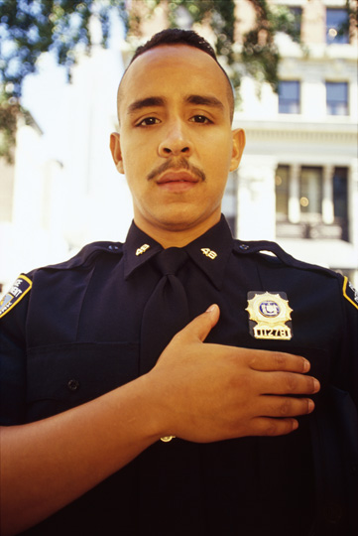
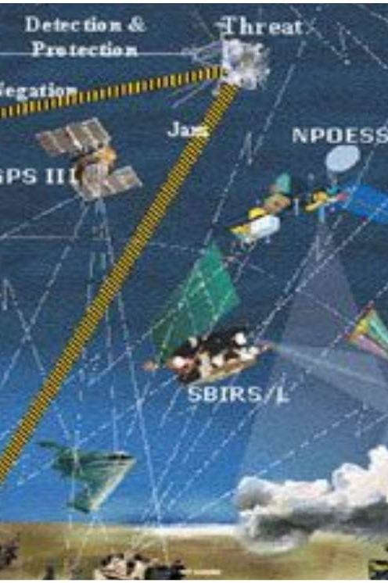
Exploring Space Deterrence:
A Game Theoretic Model to Inform Future Strategies
Krista Langeland
Bonnie Triezenberg
Ben Goirigolzarri
05 March 2019

Slide 2
How Could Policy and Investment Decisions Impact Future Space Conflict?
How could we deter escalatory action in space across a diverse set of actors?
How could current technology investments impact the outcome of a future conflict?
Could messaging and deception be used to achieve objectives in space?

Slide 3
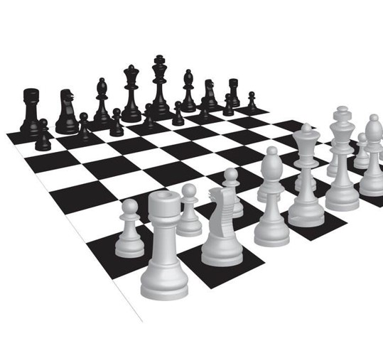
We Developed a Game Theoretic Model of Space Security and Conflict for Decision Making Support
Incorporates models of human behavior into a game theoretic representation of space conflict
Uses multi-objective optimization to represent diversity within and among players
Takes place over an extended time horizon with multiple moves

Slide 4
Simple Game Theoretic Model of Space Conflict
Players choose actions based on expected payoffs:
  If status quo maintained, gain of 5 from peaceful uses.
  If player attacks and opponent does not retaliate, Attacker sees gain of 2 and opponent loss of 1.
  If player attacks and opponent counter attacks, both lose all uses of space (zero).
Deterrence can be represented mathematically by the break even probability p
  Expected value of attacking equals expected value of maintaining status quo when 5(1-p) + 4(p) = 7(1-p) + 0
  Rationally, attack will be deterred if probability of counter strike >33%

Slide 5
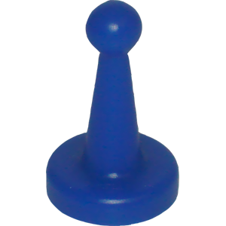
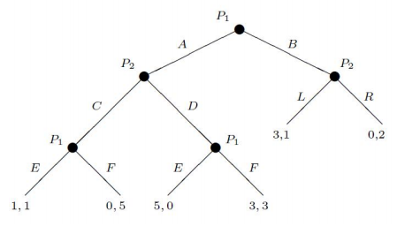

Extensive Form Game Increases Complexity Beyond 2x2
GIST Complexity is Comparable to the game of Go
Each set of actions leads to new state of the game and new decision point
Process continues until end of game or stable solution is reached
Our model is more complex than pictured here
  Plays out over multiple years
  Players have multiple choices each day
Feature | Chess | Go | Space War*
Branching Factor | ~35 | ~250 | ~10⁹
Game-tree Complexity | 10¹²³ | 10³⁶⁰ | ~10³¹⁵
Parameters | 0 | 0 | ~400
Objectives | 1 | 1 | 7
Play Style | N/A | N/A | Rational & Behavioral Model
Optimality | Pseudo optimal | Pseudo optimal | Pseudo optimal
*For 3 concurrent investments, 2 concurrent attacks

Slide 6
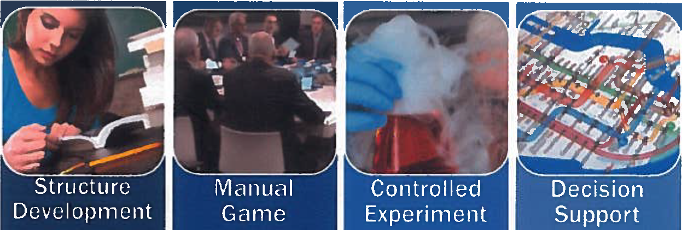
Where We’ve Been:
FY16 and FY17 Game Development and Deployment
Identify relevant political and social science theories
Develop math concepts
Develop game flow
Check that game allows moves that humans want
Verify rules
Observe players’ rationality
Code game
Conservation laws, moves, game tables
Run alternative futures one by one
Design and run full experiment
Visualize outputs to communicate knowledge
Report results

Slide 7
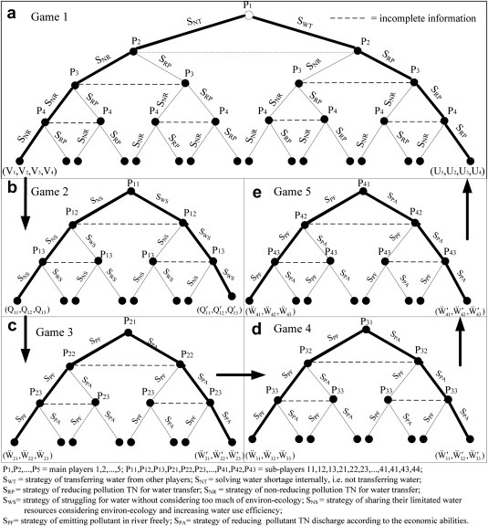
Game Design
Game Theoretic Model
Extensive Form Game Design
Behavioral Model
Game Features
DRAFT – DO NOT COPY, CITE, OR DISSEMINATE

Slide 8
Our Model Addresses Highly Idealized Assumptions of a Traditional Game
Basic Game Theory
Players are rational and have perfect knowledge of:
  Probabilities of move outcomes
  Opponent’s decision models
  All available moves
Model seeks global optimization
  Looks ahead over all possible game moves for duration of game
  Identifies equilibrium where neither player can better her welfare (per her criteria) vs. the other player
  Allows determination of optimal state
Innovations of our Model
Imperfect rationality
  Implementation rationality—players have mindsets
    Prospect Theory models human “non-rational” decision making calculus (but not “irrational”)
Non-Unitary State Actors
  Players have multi-dimensional objectives for projections of power
  Players apply different mindsets to each dimension of power
Imperfect knowledge of opponent’s mindset and capabilities

Slide 9
Basic Components of the Game

Slide 10
Game with Imperfect Rationality
M

Slide 11

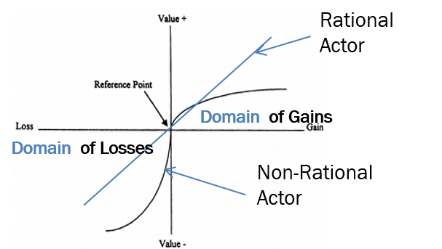
Cognitive Choice Model Represents Perceived Value for Each Player Mindset
Prospect Theory contends that actors undervalue gains and over-exaggerate the impact of a loss. Essentially, “losses hurt more than equal gains please.”
The theory illustrates the concept using a S-shaped utility, or value function.
The theory further suggests that actors are willing to accept a higher risk if it means that they can avoid a loss.
S-curve shape, based on prospect theory, represents an actor’s perceptions regarding gains and losses
Jervis, Robert. 1985. Psychology and Deterrence. Baltimore, MD: The Johns Hopkins University Press, p. 3
Kahneman, Daniel, and Amos Tversky. 1979. "Prospect Theory: An Analysis of Decision under Risk." Econometrica, Vol.47, No.2 263-292.

Slide 12
Game with Non-Unitary Actors
  States have “capital” in Political, Military, Economic, Social, Infrastructure, and Information (PMESII) domains that allow them to exert power
M
M

Slide 13
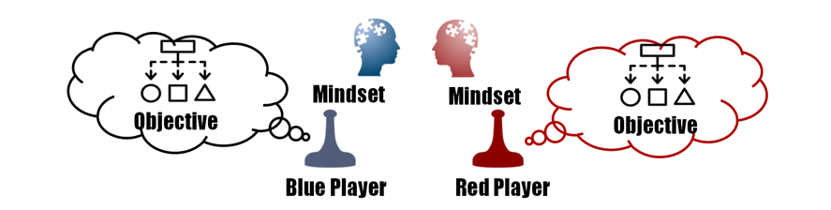
Multi-Dimensional Players Value Political, Military, and Social Capital
Objective category | Objective | Metric
Power Projection from Space | Maximize | Each state’s ability over time to project power into the theater of ground war using military, social, information and infrastructure means. M is the ability to project military power SII is the ability to shape the information environment
Political Standing | Maximize | Each state’s ability over time to project power using political means; measured relative to the state’s internal “reference point”
Relative Space Weapons | Maximize | Each state’s ability over time to develop space weapons, measured relative to the opponent’s space weapon development.
Vulnerability | Minimize Own Maximize Opponent’s | If deterrence breaks down, minimize periods of vulnerability in ground war. Vulnerability is measured against a threshold at which a state is able to project 100% of necessary space power. Redundancy builds capability above threshold. Resiliency shortens time below

Slide 14
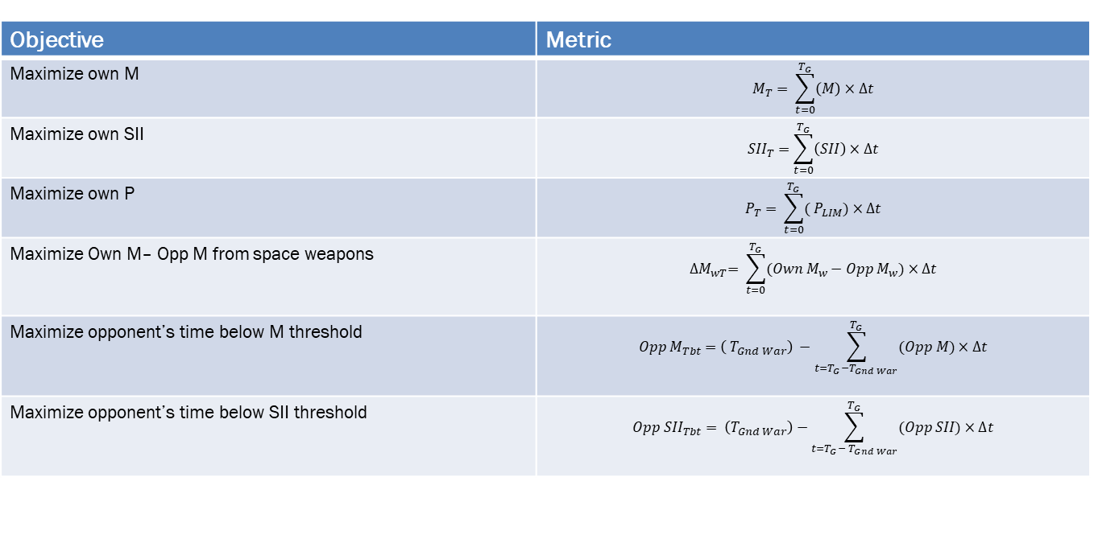
Players make decisions that maximize the integral of their objective function over the entire game
Objective | Metric
Maximize own M | $$M_{T}= \sum_{t=0}^{T_{G}}{\left(M\right)}×∆t$$
Maximize own SII | $${SII}_{T}=\sum_{t=0}^{T_{G}}{\left(SII\right)}×∆t$$
Maximize own P | $$P_{T}= \sum_{t=0}^{T_{G}}{( P_{LIM})}×∆t$$
Maximize Own M– Opp M from space weapons | $${∆M}_{wT}= \sum_{t=0}^{T_{G}}{(Own{ M}_{w}−Opp M_{w})}×∆t$$
Maximize opponent’s time below M threshold | $${Opp M}_{Tbt}=\left( T_{Gnd War}\right) −\sum_{t=T_{G}−T_{Gnd War}}^{T_{G}}{(Opp M)}×∆t$$
Maximize opponent’s time below SII threshold | $${Opp SII}_{Tbt}= \left(T_{Gnd War}\right)−\sum_{t=T_{G}− T_{Gnd War}}^{T_{G}}{(Opp SII)}×∆t$$

Slide 15
Game with Limited Knowledge
M
M

Slide 16
Perceived Knowledge Drives Game Decisions

Slide 17

Game Results and Decision Support

Slide 18
Playing the Game:
Research Questions
Offensive/defensive asymmetry
  How does adding redundancy and decreasing weapons availability impact game results?
Exploring impact of additional space situational awareness
  How does game play vary with enhanced defenses against kinetic attacks due to increased SSA?
Exploring how the ability to conceal and reveal impacts player behavior in the game
  How do misperceptions impact player success and overall deterrence?

Slide 19



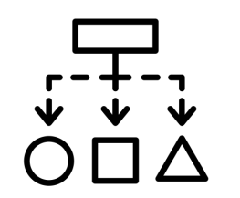
Game Setup
US vs. Peer Opponent
Players
Players have/can invest in 3 Satellite Constellations:
Military Tactical Communication
Mixed Commercial/Military Communication
Navigation (GPS/GLONASS)
Hide/Reveal
Defenses
Players have/can invest in 3 types of weapons:
Cyber thru supply chain or communication link
Ground launched kinetic (i.e. ASAT)
RF Jammers
Hide/reveal
Player objectives and triggers:
Own P, M, SII power projections
Opponent’s time below full capability to project M, SII power from space
Possession of weapon types that their opponent does not have
Hide/Reveal
Assets and Capabilities
Weapons
Objectives

Slide 20
Examining Game Outcomes: Competition and Deterrence
Who won?
Players make decisions to maximize their score
  Relative scores indicate which player has better met their objectives
Did we deter?
As policy makers and evaluators, we are interested in all of the player objectives, but also in deterrence. Therefore, we also score:
  Measure of Space Arms Race
    Time during which both sides engage in simultaneous space weapon development
  Measure of Space War
    Intensity of the Conflict
  To evaluate stability of deterrence, we also store the time history of investments, attacks and escalation
“This is not a strategy of confrontation, but it is a strategy that recognizes the reality of competition. DoD seeks to…maintain effective deterrence without dominance”
-Elbridge Colby, deputy assistant secretary of defense for strategy and force development, on the 2018 National Defense Strategy
Williams, A. (2002). Richardson Arms Race Model.
Glasl, F. (1997). Konfliktmanagement. Ein Handbuch fuer Fuehrungskraefte, Beraterinnen und Berater. Bern: Verlag Paul Haupt.

Slide 21
Game Results:
Deterrence with Offensive/Defensive Balance
Nine games over different offensive/defensive balances, for near peer adversaries (i.e. both are dependent on space)
Redundancy and Resilience as defined in Game:
Redundancy: Build and deploy “above threshold” capability such that player can absorb the attack with minimal impact
Resilience: Investments that reduce the post attack “time to recover
Fractionation – swarms of satellites that reconstitute autonomously
Reductions in failsafe and recovery time
Hardening to “operate through” cyber, directed energy, or radiation attacks
Deterrence score: Large numbers of weapons with little redundancy results in high levels of conflict intensity
Player metrics: Building redundancy is by far the most popular investment in all of these games. Why? Low risk/high payout. Resiliency via fractionation is a close 2nd. Higher risk, but higher payout since it also reduces time to implement later upgrades.
The number and color in each cell indicates the Conflict Intensity score of the game. “Red” games result in the total destruction of an orbit.

Slide 22
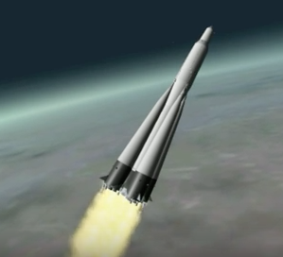
Game Results:
Additional Space Situational Awareness for Defense
Input: Probability of successful defense against an attack increases for assets with SSA protection
  Only against kinetic attacks
  Only for active defense maneuvers
Output: Results show no impact on US power projection outcomes
  A defense developed against kinetic attacks causes the adversary to adjust their attack vectors
  No significant change measured in US ability to preserve military power projection from space
Scenario | Military Power Projection Score | Scenario
US has SSA-enhanced defensive capability | = | US does not have SSA-enhanced defensive capability
Enhanced defenses shifted adversary tactics towards non-kinetic weapons, but net scores were unaffected.

Slide 23
Game Results:
Military Objectives and Hiding/Revealing Capabilities
Scenario | Adversary perception | Military Power Projection Score
Adversary perceives that we have a capability when we do not | Overestimates | With prospect theory model | With ‘rational’ model
Adversary perceives accurately that we do not have this capability | Knows truth | No statistically significant difference between having and not having capability if adversary knows the truth
Adversary perceives accurately that we DO have this capability | Knows truth
Adversary perceives that we do NOT have a capability when we DO | Underestimates | With prospect theory model | With ‘rational’ model
If the US has no co-orbital kinetics, it is to our advantage if adversary believes we do
If the US has co-orbital weapons, it is to our advantage if the adversary believes we do not
“Hence, when able to attack, we must seem unable; When using our forces, we must seem inactive; When we are near, we must make the enemy believe we are far away; When far away, we must make him believe we are near.”
-Sun Tzu, “The Art of War”

Slide 24
Observations
Game theoretic model of space conflict was developed to explore broad strategic and policy questions
  Implemented behavior models
  Added preliminary signaling capability
  Examined impact of specific capabilities
Observed results provide insight on how different investments would play out in a space conflict
  Highly vulnerable players (no redundancy) with large numbers of weapons play more aggressive games
  Hiding one’s capabilities could provide a military advantage
  Enhanced defenses against a specific weapon type may change adversary tactics but not impact

Slide 25
Where We are Now:
Recent and Ongoing Analysis
FY18 Analysis
Ongoing FY19 Analysis
Informing NRO/SAO GEO Campaign Analysis
Add an asymmetric US advantage in using Space Situational Awareness (SSA) to improve defenses
Explore impact of SSA and knowledge of SSA on game dynamics
Exploring Signaling Games
Add capability to conceal/reveal conditional triggers that result in changes to players objectives
Add capability to conceal/reveal or discover/deceive the order of battle
Explore impact of adversary misperceptions regarding existence of US co-orbital weapons
Examining impact of investment timing on game outcomes
How do adversary investments and use of weapons change with a change in our investment timing?
What is the best timing and order or prioritization for our own investments?
What is the impact of using investments and investment timing as a signal?

Slide 26
Acknowledgments
Work has been funded by NRO’s Survivability Assurance Office (SAO)
Initial proposal and funding for this work was secured by Dave Baiocchi, Geoffrey Torrington and James Pita
Tim Marler and Lisa Saum-Manning provided vital input and insights as part of the team during the game development phase
Gary Briggs advised on computing and parallelization of the code
Avata Intelligence built the software to represent our game rules and has helped with subsequent modifications
Steve Flanagan acted as Senior Advisor for recent campaign analysis

