Slide 1
TRADOC G-2
Support Concept: The TRADOC G-2 employed the Athena Simulation to computationally model three potential Chinese futures over ten years in order to evaluate the political and social outcomes of each by assessing key actor control, popular support, population mood, and the Chinese population’s satisfaction with the governance by the Chinese Communist Party (CCP).
Athena Results: A total of four conclusions were derived from the seven insights identified as a result of modeling and analysis using the Athena Simulation.
Conclusions:
The possibility of regime change in China is virtually nonexistent.
China will likely remain stable overall despite any localized disturbances and grievances.
Chinese elites are generally satisfied with the status quo of Chinese Communist Party governance.
The Hong Kong disturbances are ephemeral and their impact on the rest of China is minimal.

Slide 2
TRADOC G-2
Three scenario use cases provide a basis for comparative analysis:
Status Quo Continuation: Use Case #1 assesses the social, political, and economic conditions in China given no substantial change in the current economic situation or governing paradigm. The Chinese Communist Party governs using a status quo surveillance state.
State Capitalist Acceleration: Use Case #2 assesses conditions in China given an improving situation. To avert a looming economic and political crisis, the CCP strengthens enforcement of the rule of law through a largely apolitical and genuinely empowered anti-corruption unit. This move is enhanced by a pervasive implementation of the digital surveillance state strengthened by artificial intelligence.
The Lost Decade: Use Case #3 assesses conditions in China given a deteriorating economic situation. Massive inefficiencies and mismanagement in the state-run economy lead to the end of economic growth and stagnation in the Chinese economy. The CCP avoids serious, structural, anti-corruption reforms and instead focuses primarily on strengthening its implementation of the digital surveillance state.
Athena modeling was also used to evaluate two scenario excursions:
Hong Kong Crisis: Excursion 1 provided a vignette assessing the long-term implications of ongoing unrest and increased volatility occurring in Hong Kong.
Xinjiang Uprising: Excursion 2 provided a vignette examining the effects of a violent extremist organization moving into Xinjiang, how the CCP responded, and how these interactions influenced the local Uyghur population.

Slide 3
TRADOC G-2
Conclusion #1: The possibility of regime change in China is virtually nonexistent.
Insight 1: Popular Support for CCP Remains Stable
Regardless of the economic growth rate applied across the three use cases, nationwide support for, and popular satisfaction with, governance of the CCP declined mildly over a decade. The Lost Decade use case did produce a greater decline in popular support for the CCP, but not nearly enough to produce any significant change.
Insight 2: Popular Mood is Largely Stable
The mood nationwide initially increased and then began decreasing following a trend that roughly mirrored the greatest period of economic growth in the Status Quo and Acceleration cases. When mood was increasing, it was buoyed primarily by the population’s improving sense of safety.
Insight 3: The Lost Decade Hits Hard
The Lost Decade impacts the mood of the Chinese population much more negatively than the Acceleration case’s effects are positive. The economically vital middle class is especially harmed by the conditions of The Lost Decade. Both their mood and satisfaction with governance decline steeply over ten years.
Insight 4: The Downtrodden Endure
The downtrodden peasant civilian groups in the countryside show durable tolerance for CCP governance. Their mood declines slightly in the Lost Decade case, mostly due to weakening satisfaction with governance. In the Status Quo and State Capitalist Acceleration cases, mood sees a significant net increase, indicating the benefits of economic growth even in one of the most marginal groups.

Slide 4
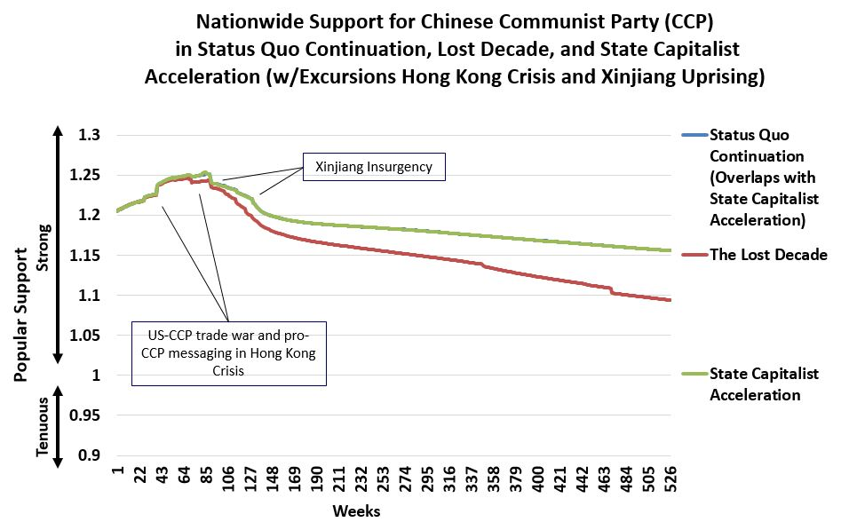
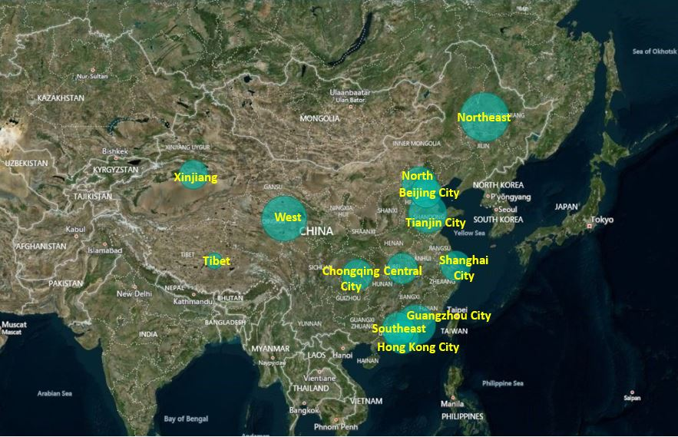
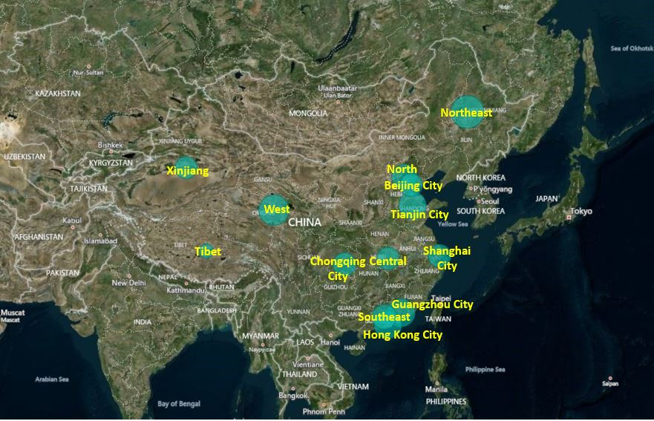
TRADOC G-2
Status Quo Continuation
The Lost Decade

Slide 5
TRADOC G-2
Conclusion #2: China will likely remain stable overall despite any localized disturbances and grievances.
Conclusion #4: The Hong Kong disturbances are ephemeral and their impact on the rest of China is minimal.
Insight 6: The Predictable Pain in Xinjiang
While mood in Xinjiang decayed sharply in all use cases, the mood of Uyghurs was slightly better under Status Quo and State Acceleration (which includes milder treatment of Uyghurs by the CCP). This suggests that if economic improvements impact Uyghurs directly, it may help mitigate their disaffection. In this excursion, the small insurgency in Xinjiang was unable to remove CCP rule or govern the area.
Insight 7: The Hong Kong Turbulence is Temporary
During and after the Hong Kong Crisis excursion, support for the Municipal Government fluctuates turbulently during the protests, but post-crisis, it is virtually identical under all use cases. Support trends slightly higher under State Capitalist Acceleration than the Status Quo. Support for the Municipal Government is slightly lower under the Lost Decade than Status Quo.

Slide 6
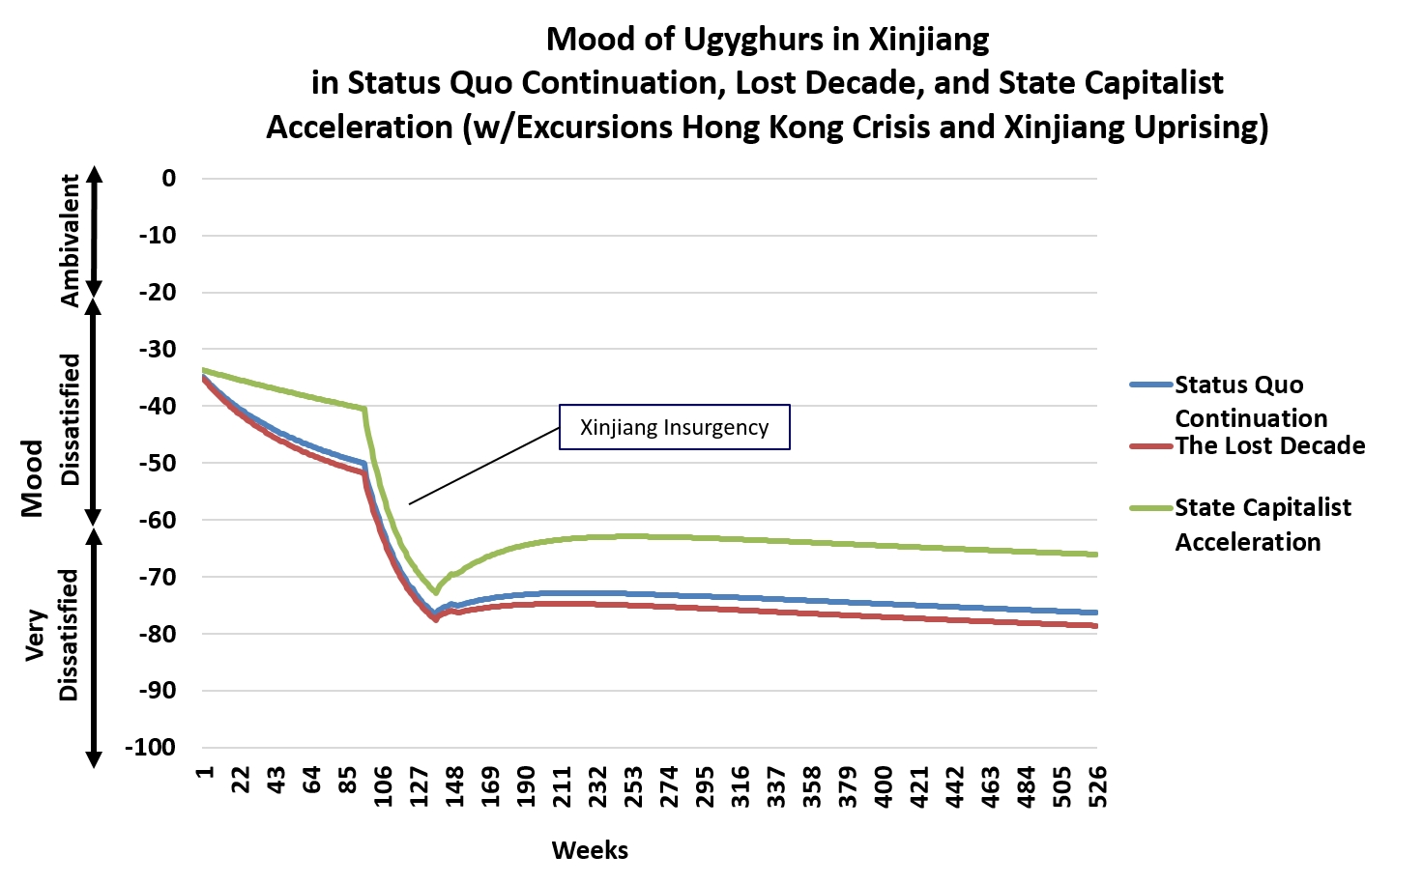
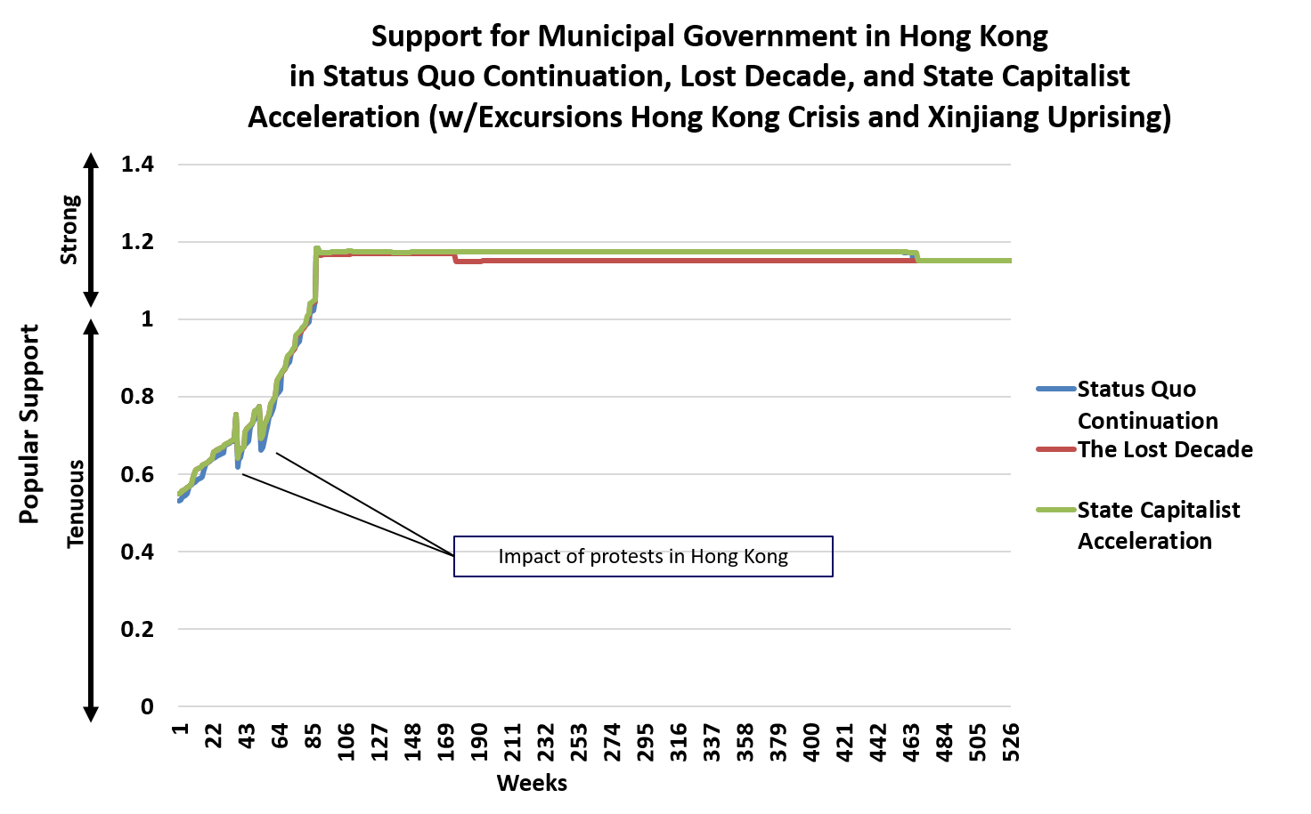
TRADOC G-2
Mood of the Uyghurs in Xinjiang
Support for the Government in Hong Kong

Slide 7
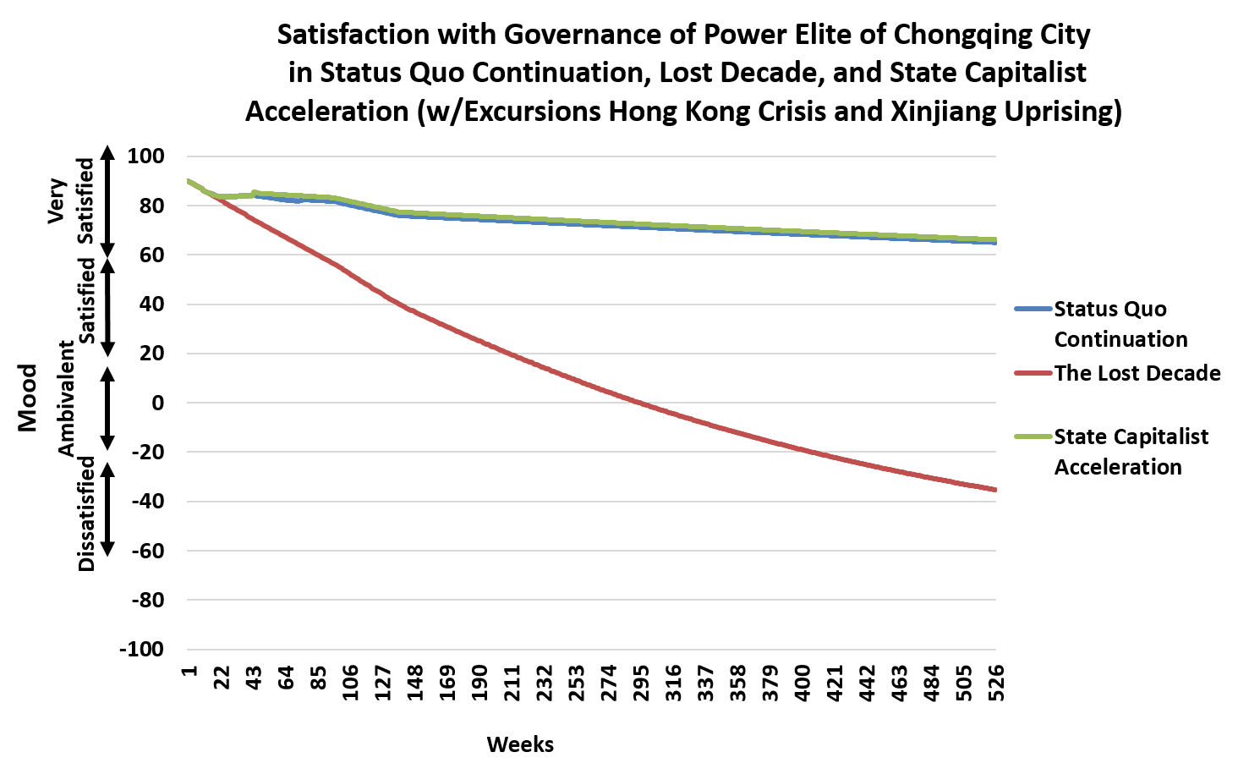
TRADOC G-2
Conclusion #3: Chinese elites are generally satisfied with the status quo of Chinese Communist Party governance.
Insight 5: The Elites are Stable
Chinese political and wealthy elites (“Power Elite” and “Well-Off” civilian groups) generally showed durable confidence in CCP governance. There are only slight declines in satisfaction with governance over all three use cases—except in Chongqing City, where elite satisfaction declines precipitously.

